Slide 1
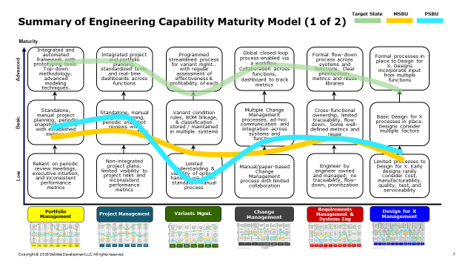
Digital Development CMM Update (1/2)
Japan CCS had very similar results to other BUs; highly dependent on tribal knowledge yet through extraordinary effort able to overcome non-optimal enablers
Preliminary Findings
Project / Portfolio Management – Capability is highly variable between teams / businesses and this lack of standardization / single source of truth limits Molex's effectiveness. Increasing capabilities in these areas will allow Molex to transition from reactive to a proactive / agile organization
Variants & Options Management – A concept that is not currently being utilized anywhere within Molex, but as the company transitions to complex engineered solutions there is an opportunity to incorporate. In the future, variation mgmt. can decrease redundant / manual effort of maintaining duplicate BOMs and increase speed / effectiveness to customer demands
Change Mgmt. – A system is in place but quality of the change management process is different depending on business / function. A “standard global but flexible” change mgmt. process can ensure cross-functional representation and appropriate rigor without decreasing speed to market
Requirements Mgmt. – Consistent pressure to increase speed to market causes a constant trade-off speed vs quality of the process. Manual linkage of requirements to designs/tests/results and downstream makes managing change impacts, audits and traceability cumbersome
Design for X – Vision for Molex is to be an innovation leader and all DfX elements that support this vision were prioritized (e.g. Marketplace, Mfg., etc.). As the company transitions to more integrated solutions, eliminating functional silos and incorporating feedback early in design is vital

Slide 2
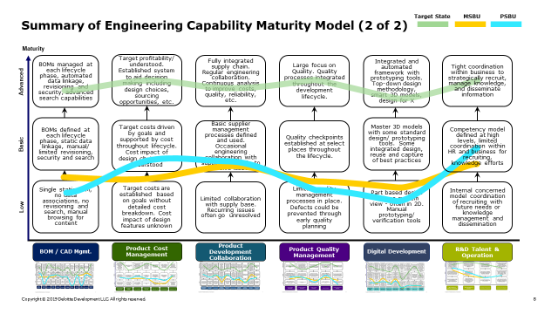
Digital Development CMM Update (2/2)
Japan CCS had very similar results to other BUs; highly dependent on tribal knowledge yet through extraordinary effort able to overcome non-optimal enablers
Preliminary Findings
BOM / Design Mgmt.- Lack of design collaboration and connected product data limits the speed and effectiveness of design; as long as the drawing remains the master Molex will be unable to digitally transform
Product Cost Management – Mistakes in cost mgmt. have large ramifications around selecting projects with low or negative margins and forcing large re-design efforts to fix the product; design for function is always prioritized over cost. Selection of profitable projects and cycle time can be greatly improved through access to accurate / real-time cost data
Development Collaboration – Lack of enterprise strategy limits the overall effectives of outsourcing, contracting, & partnerships. Viewing relationships as more of a partnership will increase efficiency and allow Molex to focus on core competencies
Product Quality Mgmt. – Tradeoff between speed to market and a zero-defect methodology is a constant struggle, finding the optimal risk tolerance is critical. Siloed data and knowledge between Design Center and Plants limits quality feedback into new designs
Digital Product Development – Data silos / lack of connected product data is the largest limiting factor in allowing the enterprise to pilot / incorporate digital capabilities into the product development cycle. Molex`s guiding principal for digital capabilities is around `speed of getting it right`
R&D Talent & Organization – Lack of strong brand / household name causes issues around recruiting top-tier talent but once talent is acquired retaining is not an issue. Through increased investment in knowledge mgmt. and learning / development Molex can greatly increase public perception as a place to develop top-tier engineering talent

Slide 3
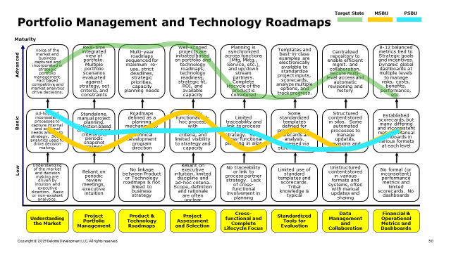
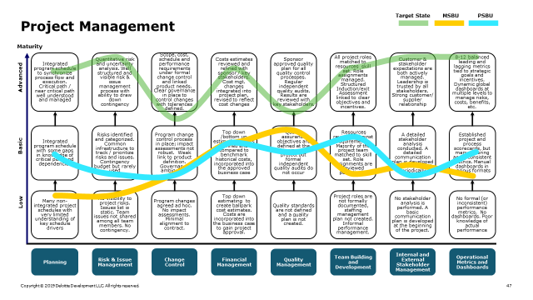
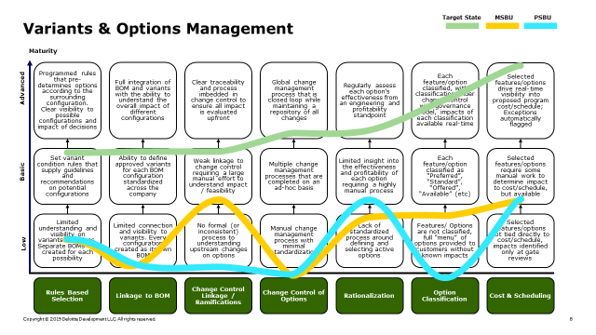
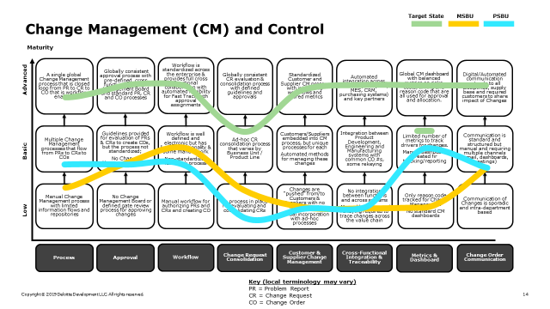
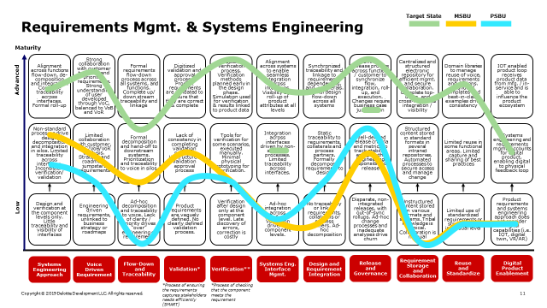
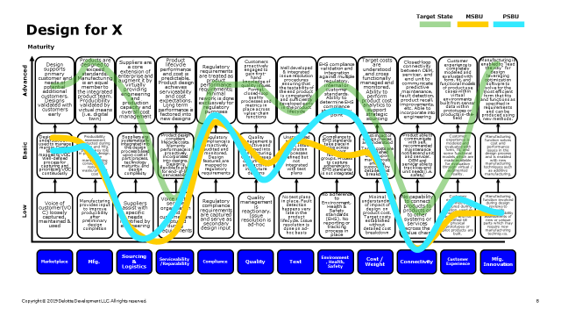
Summary of Engineering Capability Maturity Model (1 of 2)
Target State
MSBU
PSBU Yamato
Maturity
Integrated and automated framework with prototyping tools. Top-down methodology, advanced modeling techniques.
Integrated project and portfolio planning, standardized tools, and real-time dashboards across functions
Programmed streamlined process for variant mgmt.. with regular assessment of effectiveness & profitability of each
Global closed-loop process enabled via a workflow. Collaboration across functions, dashboard to track metrics
Formal flow-down process across systems and functions. Clear prioritization, metrics and reuse libraries
Formal processes in place to Design for X. Designs incorporate input from multiple functions
Advanced
Standalone, manual project planning, periodic snapshot reviews with established metrics.
Standalone, manual project planning, periodic snapshot reviews with established metrics
Variant condition rules, BOM linkage, & classification stored / maintained in multiple systems
Multiple Change Management processes, ad-hoc communication and integration across systems and functions
Cross-functional ownership, limited traceability, flow-down. Some well-defined metrics and reuse
Basic Design for X processes in place. Designs consider multiple factors
Basic
Reliant on periodic review meetings, executive intuition, and inconsistent performance metrics
Non-integrated project plans; limited visibility to project risks and inconsistent performance metrics
Limited understanding & visibility of options handled via a non-standard / manual process
Manual/paper-based Change Management process with limited collaboration
Engineer by engineer owned and managed; no traceability, flow-down, prioritization
Limited processes to Design for X. Early designs rarely consider cost, manufacturability, quality, test, and serviceability
Low
Portfolio Management
Project Management
Variants Mgmt.
Change Management
Requirements Management & Systems Eng
Design for X Management

Slide 4
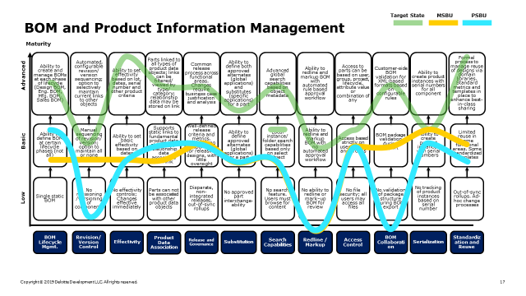
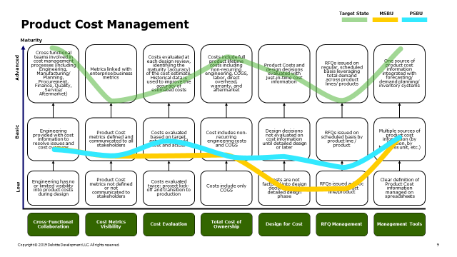
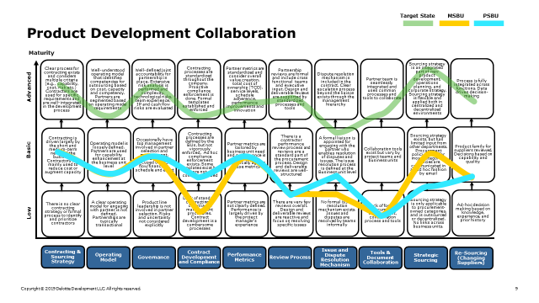
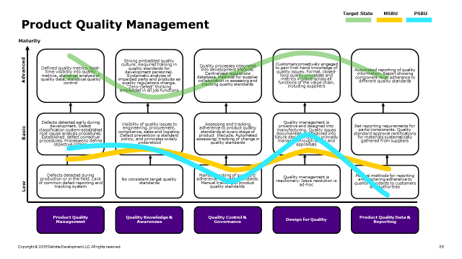
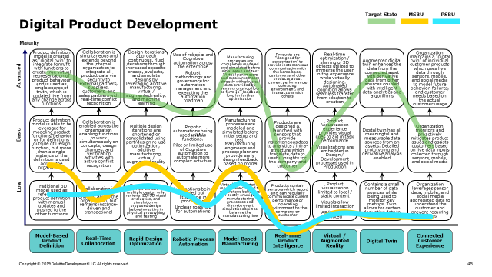
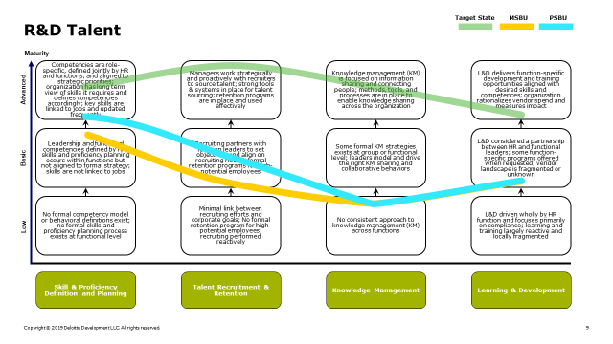
Summary of Engineering Capability Maturity Model (2 of 2)
Target State
MSBU
PSBU
Maturity
BOMs managed at each lifecycle phase, automated data linkage, revisioning and security, advanced search capabilities
Target profitability/ understood. Established system to aid decision making including design choices, sourcing opportunities, etc.
Fully integrated supply chain. Regular engineering collaboration. Continuous analysis to improve costs, quality, reliability, etc.
Large focus on Quality. Quality processes integrated throughout the development lifecycle.
Integrated and automated framework with prototyping tools. Top-down design methodology, smart 3D models, design for X
Tight coordination within business to strategically recruit, manage knowledge, and disseminate information
Advanced
BOMs defined at each lifecycle phase, static data linkage, manual/ limited revisioning, security and search
Target costs driven by goals and supported by cost throughout lifecycle. Cost impact of design choices are understood
Basic supplier management processes defined and used. Occasional engineering collaboration with suppliers, usually to resolve issues
Quality checkpoints established at select places throughout the lifecycle.
Master 3D models with some standard design/ prototyping tools. Some integrated design, reuse and capture of best practices
Competency model defined at high levels, limited coordination within HR and business for recruiting, knowledge efforts
Basic
Single static BOM, no data associations, no revisioning and search, manual browsing for content
Target costs are established based on goals without detailed cost breakdown. Cost impact of design features unknown
Limited collaboration with supply base. Recurring issues often go unresolved
Limited quality management processes in place. Defects could be prevented through early quality
planning
Part based design with no system view - often in 2D. Manual prototyping/ verification tools
Internal concerned model coordination of recruiting with future needs or knowledge management and dissemination
Low
BOM / CAD Mgmt.
Product Cost Management
Product Development Collaboration
Product Quality Management
Digital Development
R&D Talent & Operation

Slide 5
Current-State Requirements management and simulation
Pain Points
Requirements information came too late, may impact the lead time of the project
Requirements changes many times.
Requirements change causes cost change might impact the project.
Requirements sharing is not enough sometimes and it is manual.
Improvement Opportunities
Share all requirements among the team
Try to get All stakeholder agreements on fix product design
Technology / Data Utilized
Microsoft team
ECTR
NX
Simulation software
Material mechanics
Structural analysis
Thermal analysis
Mold flow
High frequency wave

Slide 6
Requirements Mgmt. & Systems Engineering
Target State
MSBU
PSBU
Maturity
Alignment across functions flow-down, de-composition and integration. Complete traceability across interfaces. Formal roll-up
Strong collaboration with customer to define and prioritize requirements. Strong understanding of user developed through VoC, balanced to VoB and VoR
Formal requirements flow-down process across all systems, and functions. Complete up/ down stream traceability and linkage
Digitized validation and approval process. Product requirements are validated to ensure that they are correct & complete
Structured verification process. Verification methods planned early in the design phase. Simulation used for verification & results linked to product data
Alignment across systems to enable seamless integration across interfaces. Visibility and roll-up of product attributes at all levels
Synchronized traceability and linkage to requirements, dependencies, and collaterals. Formal design flow-down across all systems
Common release process across functions / customer to synchronize flow, integration, roll-up, and execution. Changes require business case justification
Centralized and structured electronic repository for efficient mgmt.. and secure collaboration. Complete top-down, and cross-functional integration / visibility
Domain libraries to manage reuse of voice, requirements and designs. Standard templates and best-in-class examples drive consistency
IOT enabled product loop receives product data from mfg. / in-service and is able to influence the product ecosystem
Advanced
Non-standard processes drive design decomposition and integration in silos. Limited traceability across interfaces. Inconsistent verification/ validation
Limited collaboration with customer, VoC/VoB/VoR analysis. Strategy and roadmaps jumpstart requirements
Formal decomposition and hand-off to downstream systems. Prioritization and traceability to voice in silos
Lack of consistency in completing validation process. Unstructured validation approval process
Tools for verification for some scenarios, executed manually. Minimal physical prototyping for verification.
Integration across interfaces driven by non-standard processes. Limited traceability across interfaces.
Static traceability to requirements, collaterals and process partners. Formally decompose requirements to design
Well-defined release criteria and metrics to track stability and growth. Engineering responsible for release
Structured content stored in standard formats in several intranet repositories. Automated processes to secure access and manage change
Limited reuse in some functional areas. Limited capture and sharing of best practices
Systems engineering and requirements mgmt.. accounts for digital product, enabling digital to physical feedback loop
Low
Design and verification at the component levels only. Little traceability and visibility of interfaces
Engineering driven requirements, unlinked to business strategy or roadmaps
Ad-hoc decomposition and traceability to voice. Lack of clarity / priority drives “over” engineering of requirements
Product requirements are vaguely defined. No clearly defined validation process.
Verification after design only at the component level. Late discovery of errors, correction is costly
Ad-hoc integration across interfaces. Validation driven at component levels.
No traceability or link to requirements, collaterals or process partners. Ad-hoc decomposition
Disparate, non-integrated releases, with out-of-sync rollups. Ad-hoc change processes and inadequate analyses drive churn
Unstructured content stored in various formats and systems. Tribal knowledge is typical. Collaboration is manual
Limited use of standardized requirements or structures at individual level
Product requirements and systems engineering approach does not consider digital capabilities (i.e. IOT, digital twin, VR/AR)
Systems
Engineering
Approach
Voice
Driven
Requirement
Flow-Down
and
Traceability
Validation*
Verification**
Systems Eng. Interface Mgmt.
Design and Requirement Integration
Release
and
Governance
Requirement Storage
and
Collaboration
Reuse
and
Standardize
Digital Product Enablement
*Process of ensuring the requirements captures stakeholders needs efficiently (SMART)
*Process of checking that the component meets the requirement
Notes:
Changed pink to yellow to fit color key
Would using straight lines for the current/desired states make it seem less “90s”?
Are these categories weighted to assess total maturity for this category?

Slide 7
Requirements Mgmt. & Systems Engineering
 | Key Observations | Business Implications
Systems Engineering Approach | Utilize design tool IF with mecha system. There is one process among different products. (MSBU) Process isn’t standardized. Product development rework has consuming time because concurrent development isn’t perfectly doing. (PSBU) | Don’t need Advance capability with all clients.
Voice Driven Requirement | The environment for communicating with customers is in place, but the market has not caught up. | Most important. (PSBU) Not most important. (MSBU)
Flow-Down and Traceability | Not have enough time to action traceability. (MSBU) Cant action because takes too much cost. (PSBU) | Don’t have much value. (MSBU) Customer demand is weak because of general product. (PSBU)
Validation | There is a standard rule process but there is variation in the quality of human verification. | Quality check is most important in the business. A system that can double check the quality is required.
Verification | The accuracy of digital verification is low and the range that can be used is small. Need physical prototype to verify all. | This component is the key point of this section.
Systems Eng. Interface Mgmt. | Division of labor is progressing for each function, and system engineering has not been completed across departments. | collaboration between departments progresses is effective. Especially the effect of purchasing is large. (PSBU) Isn’t much important. (MSBU)
Design and Requirement Integration | We have acquired some traceability of DFMEA and FMEA, but there are many manual operations | It can contribute to the improvement of product maturity and can be expected to have an effect on cost.
Release and Governance | Change management and formalization can be well managed on the system. There is a mechanism to do impact analysis. (PSBU) There are release criteria but not enough. (MSBU) | Need High level governance.
Requirement Storage And Collaboration | Not standardize. Manage in SharePoint、Email、Excel etc. | Need High level. Have to discuss the process rules.
Reuse and Standardize | Culture of reuse has not been fostered yet. It takes time to search, and often not possible to use because of the data problem. | Need an environment where you can focus on advanced activity. Percentage of the reuse must be high.
Digital Product Enablement | Digital(AR・VR・IoT等)については検討していない | Need to discuss the value.

Slide 8
Current State Management Capability /Change Management
Current State Journey
Step #5
5
3
-Final customer agreement
Step #3
1
Step #1
Pre announcement to customers
- Internal Risk assessments
Define Scope of change
-customer
-product
-process
Step #6
6
Step #4
4
- Implement change @ plants
Step #2
- Internal Qualification
2
Change review by CRB
-IAR
-Notification to customer
-Risks

Slide 9
Current-State Capability /Change Management
Pain Points
The current PCN system can cover only customer’s communication
-Not cover Ends to Ends of whole supply chain, supplier, internal document, plants, lot tracking , product status,…
-Not cover proto/pre-launch
- One way automated customer notification system (To many PCN form customer POV, not unreactive)
Need to align Different requirements by industry or customer, possible risk to miss notify customers
Customer face document by Current PCN system is only English
Dashboard for only limited authorized members , not user friendly (change record tracking)
Improvement Opportunities
Change process by customer, industry or General/custom products, to cover end to end
Consistent understanding for Molex change management policy
Technology / Data Utilized
SAP
ECTR

Slide 10
Target State
MSBU
PSBU
Change Management (CM) and Control
Maturity
A single global Change Management process that is closed loop from PR to CR to CO that is workflow enabled
Globally consistent approval process with pre-defined cross functional Change Management Board and standard PR, CR and CO processes
Workflow is standardized across the enterprise & provides full cross functional collaboration with automated flexibility for Fast Track with approval assignments
Globally consistent CR evaluation & consolidation process with defined guidelines and approvals
Standardized Customer and Supplier CM process with integrated workflows and shared metrics
Automated integration across the enterprise (ERP, MES, CRM, purchasing systems) and key partners
Global CM dashboard with balanced metrics on risks, costs, timing and reason code that are all used for approval and allocation.
Digital/Automated communication extends to all disciplines, supply base and required customers to share impact of Changes
Advanced
Multiple Change Management processes that flow from PRs to CRs to COs
Guidelines provided for evaluation of PRs & CRs to create COs, but the process not standardized;
No Change Management Board
Workflow is well defined and electronic but has limited functionality & some manual work
Non-standardized fast track process
Ad-hoc CR consolidation process that varies by Business Unit / Product Line
Customers/Suppliers embedded into CM process, but unique processes for each
Automated methods for managing these changes
Integration between Product Development, Engineering and Manufacturing systems with common CO #s, some rekeying
Limited number of metrics to track drivers for changes.
Manual dashboards created fir tracking/reporting
Communication is standard and structured but manual and requiring multiple channels (email, dashboards, meetings)
Basic
Manual Change Management process with limited information flows and repositories
No Change Management Board or defined gate review process for approving changes
Manual workflow for authorizing PRs and CRs and creating CO
No process in place for evaluating and consolidating CRs
Changes are “pushed” from/to Customers & Suppliers with no involvement
Manual incorporation with ad-hoc processes
No integration between functions and across systems
Manual look-ups and rekeying required to trace changes across the value chain
Only reason code tracked for Change Management
No standard CM dashboards
Communication of Changes is sporadic and intra-department based
Low
Process
Approval
Workflow
Change Request Consolidation
Customer & Supplier Change Management
Cross-Functional Integration & Traceability
Metrics & Dashboard
Change Order Communication
Key (local terminology may vary)
PR = Problem Report
CR = Change Request
CO = Change Order

Slide 11
Change Management (CM) and Control
 | Key Observations | Business Implications
Process | System exists, but process is not end-to-end. Tracking is done manually （MSBU） Process is different by product type, but no relation in function between products（PSBU） | System should be one, and should have standardized process. On the other hand, there might need to have different process for certain products.
Approval | Should be across all business units, but there are some left out Mainly done manually(e.g., raising hands) | Approval process need to be in advanced level. Must have process that has continuous reliability from customer
Workflow | Workflow exists, but base is for automotive, not enough flexibility. （MSBU） Workflow exists, but not thorough. Some rework related to quality（PSBU） | Need flexibility in process（MSBU） Need to standardize for better quality（PSBU）
Change Request Consolidation | Does not have function across oversea / Business units（MSBU） For some materials, making decision carefully as a whole solution（PSBU） | No need for global standard as there are too many change requests
Customer & Supplier Change Management | Not strong enough relationship with supplier, one way communication Confirm to supplier by email / phone for tracking information | Have more close communication with supplier, with system supporting tracking information Need visibility and keep record of communication history between suppliers
Cross-Functional Integration & Traceability | No cross-function traceability Unrealistic to consolidate all as there are too many processes. Focus on end result would be one idea Need manual work to incorporate any change, not efficient | Traceability is important for business perspective. Must be able to respond to the request from medical / automotive customers
Metrics & Dashboard | No dashboard, but not many issues（MSBU） Dashboard exists, and being able to track KPI, but some are left behind（PSBU） | Dashboard might be necessary, but not primary focus（MSBU） Need dashboard which can evaluate different types of product / KPI（PSBU）
Change Order Communication | Email base, but good communication with customer Quality of communication is not enough, need form template | Need to raise the level of communication with customers Sometimes, there are cases where information is not correctly informed to manufacturing, which leads to high business risk

Slide 12
Current-State Capability BOM Management
Current State Journey
Step #5
5
3
SAP Loading
Local Design Center Load
Plant Level Load
EHS/Compliance Checks
Step #3
1
Step #1
Documenting Engineering BOM(PDD)
Detailed Engineering Design
Step #6
6
Step #4
4
Plant Sustaining
Step #2
Project Plan Approval
PAR
Vender Selection
Manufacturing Locations
2
Design Review
Feasibility Study
Final Material Selection

Slide 13
Current-State Capability BOM Management
Pain Points
Consume a lot of time (Set of MM is needed as pre-process, manual or batch program is used for data entry.)
BOM definition (E-BOM,P-BOM) is not consistent. (Need to revise if production is moved.)
No automated systems (Drawing and Model are not direct linked to BOM. Need to revise by manual when it changes. There is no systematic check of incorrect data such as typo.
Manual track causes a delay of BOM set up. There is no systematic alert or notification.
No data linking system for suppliers (All suppliers data is inputted by manual)
Improvement Opportunities
Automate SAP loading process including suppliers’ data
Unify the definition of BOMs so that it can be used at all sites without any change
Automate data check system
Automate tracking and alert system
Technology / Data Utilized
ECTR
NX
SAP
GRANTA

Slide 14
Target State
MSBU
PSBU
BOM and Product Information Management
Maturity
Ability to create and manage BOMs at each phase of lifecycle (Design BOM, Eng. BOM, Mfg. BOM, Sales BOM)
Automated, configurable revision/ version sequencing; option to selectively maintain current links to other objects
Ability to set effectivity based on lot, dates, serial number and other product criteria
Parts linked to all types of product data objects; links can be filtered/ viewed by type/ category; relationship data may be stored on link
Common release process across functional areas. Changes require business case justification and analysis
Ability to define both approved alternates (global applications) and substitutes (specific applications) for a part
Advanced global search capabilities based on object metadata
Ability to redline and markup BOM with automated rule based approval workflow
Access to parts can be based on user, group, project, lifecycle, attribute value or combination of any
Customer-side BOM validation for XML-based formats based on configurable rules
Ability to create product instances with serial numbers for all component
Formal process to manage reuse of designs via domain libraries. Standard metrics and templates in place to enhance best-in-class sharing
Advanced
Ability to define BOM at certain lifecycle phases (not all)
Manual sequencing of revision/ version; option to maintain all or none object links
Ability to set basic effectivity based on dates
Supports static links to fundamental product data objects; no relationship data associated with link
Well-defined release criteria and metrics. Engineering responsible for releasing designs, with little oversight
Ability to define approved alternates (global applications) for a part
Local instance/ folder search capabilities based only on select object
Ability to redline and markup BOM with no automated approval workflow
Access based strictly on users, roles and groups
BOM package validation during export
Ability to create product instances with serial numbers
Limited reuse in some functional areas. Some standardized templates
Basic
Single static BOM
No revisioning /versioning of components
No effectivity controls; Changes effective immediately
Parts can not be associated with other product data objects
Disparate, non-integrated releases, out-of-sync rollups
No approved part interchange-ability
No search feature. Users must browse for content
No ability to redline or mark–up BOM for review
No file security; all users may access all files
No validation of package structure during BOM export
No tracking of product instances based on serial number
Out-of-sync rollups. Ad-hoc change processes
Low
BOM Lifecycle Mgmt.
Revision/ Version Control
Effectivity
Product Data Association
Release and Governance
Substitution
Search Capabilities
Redline / Markup
Access Control
BOM Collaboration
Serialization
Standardization and Reuse

Slide 15
BOM and Product Information Management
 | Key Observations | Business Implications
BOM Lifecycle Mgmt. | Drawing-BOM, EBOM, MBOM, PBOM, (Bill-substance BOM) exists, but no relation between BOMs。Part number attribute is maintained manually, taking lots of time（MSBU） Purpose of P-BOM management is not clear（PSBU） | Should reduce manual work of BOM creation, traceability, change management by managing BOM by single source Sales BOM is no longer necessary
Revision/ Version Control | No revision management. Design change sometimes not reflected to BOM（PSBU） Version change includes date and PIC. Changes in supplier part is not reflected to BOM. Very difficult to track changes from BOM（MSBU） | Customer does not complain much about BOM changes
Effectivity | Does have record of when changed, but does not have visibility to implication of other business unit / regions（PSBU） Implication can be identified by spending time manually （MSBU） | Implication should be visible by every attribute, such as serial / batch number
Product Data Association | Does have part number, but no relation among part / material / plant / BU（MSBU） Able to manage many attribute（PSBU） | More benefit on supply chain and customer
Release and Governance | It is standardized in Japan, but has different rules from other countries. There are many manual operations for management.（MSBU） There are standardized rules, but they are inadequate and the responsible person is unclear. The agreement with manufacturing is difficult and can not get time.（PSBU） | Need global standard process, which is also efficient
Substitution | Substitution exists, but many manual work associated with BOM replacement (PSBU） No specific rules for replacement, other members cannot recognized part has been replaced （MSBU） | Need definition of substitution, but should not require rigorous management
Search Capabilities | There is a search system but some departments can not search. Attribute information is not enough. | Want to be able to easily find and divert.（MSBU） At least it needs to be able to narrow down from the search results（Eliminate Excel Export）（PSBU）
Redline / Markup | It is NA because it is not carried out in business. | It is necessary in the future.
Access Control | There is access control but no detailed control for each part. Control by group in SAP. | Fine access control is not required.
BOM Collaboration | It is NA because it does not require BOM coordination with suppliers or customers for general products.（PSBU） Cooperation with suppliers and customers with BOMs, and validation as necessary.（MSBU） | It is necessary to strengthen the coordination of BOM. (MSBU)
Serialization | Strictness is required by the customer and can be handled.（MSBU） Number management in ASSY-Parts as needed.（PSBU） | It is enough at present.
Standardization and Reuse | Some standardization is in progress, and materials can be reuse.（MSBU） Reuse of BOM is also possible.（PSBU） | Need for efficiency and cost reduction. Need a system to make all members available for reuse.

Slide 16
CAD Design/Management
Current State Journey
Step #5
Quotation phase, generally we create 2D drawings and DFM on each components.
Material selection are tentative, material are decided by be communicated each department.
Step #7
Re-use on other concept
7
Step #3
Creating concept phase, we design on “NX” cad system and storage to ECTR system.
5
3
1
Step #1
Make definition of design intents and design priority on “Scope review”
6
Step #6
Design drawing release
4
Step #4
Design analysis phase, we need to do tolerance analysis under mating motion. And as another analysis, we are doing contact force, mating force and retention force as FEA analysis and clarify mold part weakness point as mold flow analysis for, SI analysis and temperature analysis.
2
Step #2
Part number assignment on ECTR system.
These number will be as SAP material master number.

Slide 17
CAD Design/Management
Pain Points
On modeling..
In current parametric design cad system, user are using preferring commands and design flow. Created model are difficult to understand design intents for another engineer. (perhaps this will be barrier to around clock design)
Design knowledges and procedures are stored in another system and each local drives, engineer waste time for searching documents for needed.
Product are designed by one engineer.
On Analysis..
Needing analysis list are leaved to design engineer, the least of analysis menu are not exist.
Analysis data are stored on each engineer local folder and/or local share folder.
Some excel base design analysis tool are not managed.
Time consuming on tolerance analysis on NX cad model.
Analysis tools are differ on analysis purpose, engineer need to know each usage.
On model management for re-usable..
Difficult for search similar product model as "concept base model" on ECTR system.
Improvement Opportunities
On modeling..
Standardize modeling method and rule
Need to organize the design knowledges and design procedure. If these document will be accessed from CAD system, design process will be efficiently.
Team engineering design
On Analysis..
Needed analysis list will be listed up in D-FMEA and stored in stature system. If stature system will be linkage to cad system, engineer will more easy to considering.
Need to clarify rules t storage area. (e.g.: ECTR)
Localized excel files should be extracted and managed.
Need to study for efficiently cad system usage or add-on soft ware.
If all analysis tool will be linkage to CAD system and analysis will can be minimize operation, design process will be more speedy.
On model management for re-usable..
If easy to search on data base like as pitch size, connector variation and current ratings, we will more accelerate legacy model re-use.

Slide 18
Target State
MSBU
PSBU
Design (CAD) Management and Collaboration
Maturity
Fully annotated 3D models with embedded assembly / manufacturing information. Top-down design leveraging libraries of building blocks. Design for X and for long term product platforms
Robust simulation lifecycle management process is in place. Engineering analysis is linked with design data and managed throughout the lifecycle
Majority of the validation of drawing, assembly, integration and manufacturability automatically done at check-in time. Verification up to system level. Errors are discovered and fixed early
Synchronized traceability and linkage to requirements, dependencies, and collaterals. Formal design flow-down across all systems, and process partners
Common release process across functional areas to synchronize flow, integration, roll-up, and execution. Changes require business case justification and analysis across all affected systems
Centralized and structured electronic repository to enable efficient mgmt., secure collaboration, and feedback of designs / processes across systems / geographies
Formal process to manage reuse of designs via domain libraries. Metrics to track reuse and net new content. Standard templates and best-in-class examples
Automated, configurable revision/ version sequencing; option to selectively maintain current links to other product data objects
Advanced
3D model is master. Some top-down design and library use in silos. Short-term design focus with sub-system level view. Common corporate methodology
The link between engineering analysis and design is maintained manually by engineers on local drives
Tools for verification for some scenarios, executed manually. Minimal physical prototyping for verification. Some verification of integration to sub-system level
Static traceability to requirements, collaterals and process partners. Formally decompose requirements to design, and some formal hand-offs to process partners
Well-defined release criteria and metrics to track design quality and stability. Engineering responsible for releasing designs, but with little oversight
Structured content stored in standard formats in several intranet repositories. Automated processes to secure access and manage updates, revisions
Limited reuse in some functional areas. Some standardized templates defined for critical deliverables. Limited capture and sharing of best practices
Manual sequencing of revision/ version; option to maintain all or none product data object links
Basic
2D drawing is master. 3D drawing is missing or out of sync. Part based design focus with no system level view
Engineering analysis is not linked to design. Relationship between analysis and design is not preserved.
Verification after design only at the component level. Late discovery of errors, correction is costly. Manual or physical verification typical
No traceability or link to requirements, collaterals or process partners. Ad-hoc decomposition, lack of clarity drives “over” engineering
Disparate, non-integrated releases, with out-of-sync rollups to upstream releases /milestones. Ad-hoc change processes
Unstructured content stored in various formats and systems. Any sharing is manual, inconsistent, unsecure, and time-consuming
Clear definition of roles but limited standard templates. Unmanaged reuse and productivity gains at an individual level
No revisioning /versioning of artifacts
Low
Design Methodology
Integrated Design Tools
Validation and Verification
Integration and Traceability
Release and Governance
Content Mgmt and Collaboration
Standardization and Reuse
Revision/ Version Control

Slide 19
Design (CAD) Management and Collaboration
 | Key Observations | Business Implications
Design Methodology | There are 3D models and 2D models, but 2D is the master and 3D is just reference information.（MSBU・PSBU） | Want to be High Advance to increase the density of customer contacts.
Integrated Design Tools | Although there is a flow to confirm simulation by DR, the procedure of simulation is not standardized. It is necessary to ask the engineer about the result and process. | Want to share Design result to downstream process as High Advance.
Validation and Verification | Although we are checking the validity, there may be cases where the functionality is lacking. In particular, confirmation of manufacturability and assembly may be delayed. The current situation is finding manufacturing requirements based on experience. It should include the process of trial production examination time（MSBU） | Want to do as much verification as possible with CAD.
Integration and Traceability | ECTR provides a limited view of the impact of changes, but not all can be visualized.（PSBU） All information related to ECTR is not stored.（MSBU） | Not much demand from customers about traceability.
Release and Governance | Technical information is not stored in ECTR, but may be stored only in Email and local folders. Therefore, it takes time to search for information. | Want to manage master data as High Advance, but in practice it is difficult due to time constraints. Flexibility is required according to the customer. If 3D data standard operation is assumed, the priority is not so high.
Content Mgmt and Collaboration | Mostly stored in SharePoint, Email. Even if stored in ECTR, there is no cooperation with CAD. | Want to centrally manage together with CAD data in ECTR. It is difficult to share models between remote oversea bases.
Standardization and Reuse | Reuse is used in part, but diversion to new design is difficult.（MSBU） The need for reuse is high, but standardization has not progressed much.（PSBU） | For general products, it is necessary to utilize template models.（PSBU） Because there are many custom products, standardization is not very important.
Revision/ Version Control | There are cases where design is shared by email, and version control is not possible. | Thorough version control is necessary.

Slide 20
Current-State Capability Product Quality Management
Current State Journey
Step #5
5
3
Step #3
Mass Production
Safe Launch
Reduction of variation
Continuous Improvement
1
Step #1
Process Development
- PFMEA
Process Flow
Control Plan
Planning
- DMF
Quality Target
Feasibility study
6
Step #4
4
Step #6
Step #2
Product and Process Verification
FAI
Process capability study
MSA
EOL
2
Product Development
DFMEA
Product Specification

Slide 21
1. Process control 1) Product development process
Planning
Project Approval
Pilot
Trial
Mass
Production
NPD Request Form
Project review
Concept review
Design review
Final Review
Phase review
Product release
Business
Strategy
Design Specification
Checklist
NPD
completion report
Customer’s
Requirements
Marketing
DFMEA
Drawings &
Specification
P-FMEA
Planning
Feedback
⇒Continuous Improvement
^{Phase.1-3} Planning
Process
flow chart
Pre-Launch
Control Plan
^{Phase 4} Product Development
Product
Specification
Quality Target
^{Phase.4} Process Development
Reduction of
process
variation factor
Process
Capability
Process
Feasibility
^{Phase.5-6} Product & Process Verification
NPD Planning & Proposal Form
Mass
production
Evaluation
^{Phase.7-8} Mass Production
Dimension
Function
Initial
Process Study
MSA
MP
Control Plan
PPAP
Customer
Approval

Slide 22
Current-State Capability /Product Quality Management
Pain Points
No consistent product quality target (Manufacturing/NPD). VS. Varieties of customer’s requirements of product quality
It is difficult to align the concept of quality / definition of words. separately by people ,department, and region. Sometimes not data oriented, it judges by the impression
There is no consistent quality process to cover end to end
(e.g, DFMEA⬄ EPFMEA ⬄ PFMEA)
Reactive quality system (Event/Incident driven)
Improvement Opportunities
Define the process to determine product quality target in early stage of NPD (Customer’s DPM/Manufacturing quality/Reliability, and supplier’s quality)
Employee Quality Understanding/mindset
Molex global quality policy/standard and governance to cover end to end (NPD => Manufacturing => EOL)
Quality dashboard to monitor and control real time quality (SPC, DPM, process data, vision data, by M/C, by P/N, supplier products/components …)
Linkage between development data and mass production data
Technology / Data Utilized
SAP
ECTR
STATURE (FMEA)
SharePoint
Air 2 (Inspection data monitoring)
MII

Slide 23
Target State
MSBU
PSBU
Product Quality Management
Maturity
Defined quality metrics. Real-time visibility into quality metrics, statistical analysis of quality data, statistical quality control
Strong embedded quality culture. Required training in quality standards for development personnel. Systematic analysis of impacted parts and products as quality regulations change. “Zero-Defect” thinking embedded in all job functions
Quality processes integrated into development lifecycle. Centralized regulations database. Methods for supplier collaboration in assessing and tracking quality standards
Customers proactively engaged to gain first-hand knowledge of quality issues. Formal, closed-loop quality processes and metrics in place across all functions of the value chain, including suppliers
Automated reporting of quality information. Report showing component-level adherence to different quality standards
Advanced
Defects detected early during development. Defect classification system established root cause analysis procedures. Established defect corrective procedures. Processes to define objective criteria
Visibility of quality issues to engineering, procurement, compliance, sales and logistics. Defect prevention is standard policy, and principles widely understood
Assessing and tracking adherence to product quality standards at every stage of product lifecycle. Automated assessing/ tracking of change in quality standards
Quality management is proactive and designed into manufacturing. Quality issues documented and factored into future designs. Quality primarily managed through audits and appraisals
Set reporting requirements for parts/components. Quality standard approval certifications for materials systematically gathered from suppliers
Basic
Defects detected during production or in the field. Lack of common defect reporting and tracking system
No consistent target quality standards
Manual tracking of suppliers’ adherence to quality standards. Manual tracking of product quality standards
Quality management is reactionary. Issue resolution is ad-hoc
Manual methods for reporting and declaring adherence to quality standards to customers and authorities
Low
Product Quality Management
Quality Knowledge & Awareness
Quality Control & Governance
Design for Quality
Product Quality Data & Reporting
Notes:
No statistical quality control; rely on EDART no analysis completed , during Product development process no metrics
We so far away from understanding what it takes to get to zero-defects; inputs operators perceive have tons of defects (do not treat everything done as a defect; competency level across other companies are higher)
Supply base is currently small but as Molex moves to tier 1 supplier Molex is currently not able
Not included in the early process
If we get more advanced supply base Molex would grind to a halt; unclear direction provided to suppliers
Feedback to post production back to engineering is very weak because the PDT falls apart after PPAP; AQP & team falls apart because there is no sustainment (in the plant they are called QE; handoff is not well defined
Can be tons of defects but no QNs because no one wants to deal with; sometimes the 8D (Ask Chengdu about the process)

Slide 24
Product Quality Management
 | Key Observations | Business Implications
Product Quality Management | Depend on the product, defect , sometime detected by customer. (MSBU) Setting DR to prevent the defect, but depend on the people in charge. (PSBU) | Takes too much cost, target Middle Advanced.(MSBU) Need to have highest quality.(PSBU)
Quality Knowledge & Awareness | Storage quality knowledge and have mind to analysis/feedback to product development, but not action yet. | Low Advance because balance with lead-time.
Quality Control & Governance | Quality is controlled in some of the product but it takes time. (MSBU) Quality is controlled, but there is much manual work. Trekking mistakes have a major impact on business. (PSBU) | Although it is important to emphasize, it does not have to be the best in the industry.
Design for Quality | The quality aspects of the design are considered enough, but cross-functional feedback loops may not work. (PSBU) Quality defects often occur and we have not taken measures to prevent them. (MSBU) | Need to be a leading company on the market
Product Quality Data & Reporting | Reports to customers are not formatted and is mail basis. However, there is no demand from customers and there are no major issues. May be troubled if the customer is asked to submit again later. (PSBU) Have data, but I manually create a report and it takes time. (MSBU) | Need a dashboard and analysis process that visualizes the KPIs that contribute to decision making

Slide 25
Current-State Capability Digital Product Development
Current State Journey
7
Mass productivity
confirmation
5
Production validation
- Inspection Standard creation
and inform to manufacturing
location by ***
- Early stage (Start-up)
instability control
3
Equipment manufacture
And Preproduction
1
Product design
- FAI (quality evaluation report)
- 3D model design,
3D->2D conversion,
2D creation with NX CAD system
- Mold Die/Stamping Die/
Assembly machine manufacture
- Preproduction
- 3D and 2D storing into the ECTR
and informed to related
department automatically
- Analysis with CAE tooling
- Storage of FMEA into Stature
6
Product Release
4
Design verification
- Release information announcement
to the related department by E-mail
- Environmental data approval
with MAS System
2
Equipment design
- Engineering evaluation
- Update of SAP sales status
- Mold Die/Stamping Die
/Assembly machine design
- Product SPEC. test and storage of test report into ***
- Packaging evaluation
Notes:
This is a Current state capability of Product Development focused on digitalization.

Slide 26
Digital Product Development
Target State
MSBU
PSBU
Maturity
Product definition model is created as “digital twin” to integrate form/fit with functions to create true virtual representation of product behaviour and is used as single source of truth, which is updated live from any change across functions
Collaboration is simultaneous and extends beyond the internal organization to integrate all product data via security to external partners, suppliers, customers, and sales partners with real-time conflict recognition
Design iterations approach continuous, fluid iterations through increased speed to create, evaluate, and simulate designs by leveraging additive manufacturing, virtual / augmented reality, and machine learning
Use of robotics and Cognitive automation across the enterprise
Robust methodology and governance for automation management and executing the automation roadmap
Manufacturing processes are completely modeled and simulated before initial setup and test. Virtual parameters and measures match directly with physical data provided by sensors on shop floor to form IoT feedback loop for further optimization
Products are “designed for sensorization” to provide instantaneous communication with the home base, customer, and other products about current performance, operating environment, and interactions with others
Real-time optimization / sharing of 3D objects utilized to immerse the user in the experience while virtually designing. Automated cognition allows seamless transfer from ideation to creation
Augmented digital twin enhances the data from the connected asset with derivative data from other sources coupled with intelligent data analytics and algorithms
Organization maintains a “digital twin” of individual customer products which uses live data through sensors, mobile, and social media to model future behavior, failures, and customer needs based on the actual customer usage
Advanced
Product definition model is able to be leveraged for modeling product functions/behavior or for definitions outside of Design function, but more than a single instance of the definition is used across the organization
Collaboration is enabled across the organization enabling functions to work simultaneously on concepts, design changes, and verification activities with active conflict recognition
Multiple design iterations are shortened or consolidated using part/design re-use optimization, additive manufacturing, virtual / augmented reality
Robotic automations being used within functions.
Pilot or limited use of Cognitive automation to automate more complex activities
Manufacturing processes are modeled and simulated before initial setup and test. Manufacturing engineers and process planners provide early design feedback based on model behavior
Products are designed & launched with sensors that provide instantaneous data to analytics / infra-structure which translate data to useful insights for the company and customer
Product Visualization experience provides visual cues to aid in task performance
Visualizations are embedded in Design / Development processes used in Production
Digital twin has all meaningful and measurable data sources from an assets. Detailed prototyping and derivative analysis enabled
Organization monitors and proactively mitigates product issues and assists customers based on live data inputs collected through sensors, mobile, and social media
Basic
Low
Traditional 3D model used as reference for product definition with manual updates and pushed to the other functions
Collaboration is electronically enabled across the organization, but remains instance-driven and transactional
Design iterations follow contain multiple design-only reviews, 2D/3D visual evaluation, and simulation on proposed design before investing in physical prototyping and testing
Automations being piloted but little/none in production
Unclear roadmap for automations
Virtual manufacturing models are created to understand behaviors of costly or unique manufacturing processes and discrete event simulations built to balance the manufacturing line
Products contain sensors which record and can regularly communicate current performance or operating environment to the company or customer
Product visualization limited to local / static content
Visuals allow limited interaction
AR/VR being piloted
Contains a small number of data sources while being used to monitor key metrics. Twin allows for certain derivative data to be generated
Organization leverages sensor data, mobile, and social media aggregated data to understand the customer and prevent recurring issues
Model-Based Product Definition
Real-Time Collaboration
Rapid Design Optimization
Robotic Process Automation
Model-Based Manufacturing
Real-Time Product Intelligence
Virtual / Augmented Reality
Digital Twin
Connected Customer Experience
Notes:
Changed pink to yellow to fit color key
Would using straight lines for the current/desired states make it seem less “90s”?
Are these categories weighted to assess total maturity for this category?

Slide 27
Digital Product Development
 | Key Observations | Business Implications
Model-Based Product Definition | MSBU: 3D model is utilized to create the 2D drawing; except for pockets of simulations PSBU: Drawing is the master and the model is only utilized upfront and manual data connections are required | Data is soloed Molex is losing a lot of value by not connecting the model to all relevant data (simulations, analysis, testing results, etc. Limited capability here has held Molex back from exploring other digital capabilities
Real-Time Collaboration | MSBU: No real-time collaboration with several tools and rely on check-in / check-out methodology forcing version control PSBU: Manual collaboration is required very limited real-time instances | Molex finds value of real-time collaboration both internally and externally; currently tools need to be upgraded to allow Fluid compatibility with suppliers / customers is required for any value to be achieved; disconnect will make this worthless
Rapid Design Optimization | MSBU: Simulations / 3D modeling is currently being completely but due to creating micro products the team is limited PSBU: Limited usage of additive or AR / VR to optimize design; CAD and pockets of simulations are utilized today | Speed to market is pivotal but the team perceived diminishing returns due to tooling being the longest lead item not being addressed by this capability
Robotic Process Automation | MSBU: Technology being utilized in pockets but does not have a strategic vision or roadmap PSBU: Very similar to MSBU | RPA is a strong technology but use-cases / usage will be limited (e.g. SAP data entry, design validation, etc.) Frequent complex designs limits the applicability of the capability
Model-Based Manufacturing | MSBU: Capability is utilized in the pocket, limited process simulation PSBU: Rely on tribal knowledge to know if the manufacturability of the product is satisfactory | Critical functionality to drive Molex towards having smart factories, allowing the company be connected from product ideation through sustainment
Real-Time Product Intelligence | MSBU: N/A PSBU: N/A | Extremely limited applicability due to the products / way the products are being utilized in the market
Virtual / Augmented Reality | MSBU: Capability is being explored but not currently utilized within the group PSBU: Similar to MSBU | Limited value driven use-cases does not make these a priority for Molex (e.g. design concurrently across locations, certification of workers, etc.)
Digital Twin | MSBU: Currently have electronic representation but not a virtual twin yet; the data is currently connected in this manner PSBU: Similar to MSBU | Concept is foreign to the group and understand the applicability but cannot fully in vision how this capability will work in the future
Connected Customer Experience | MSBU: Limited usage / applicability PSBU: Same as above | Molex can creatively y utilize these capability to differentiate but in most cases / products the capability is not applicable

Slide 28
Current-State Product Portfolio Management
Current State Journey
Step #5
5
3
･Product release
Step #3
1
Step #1
・Project Scope
・Financial metrics
・Determine schedule
- Program/technology road map
6
Step #6
Step #4
4
・Performance tracking
2
Step #2
・Tooling and design release
RPM system
Practices PDP

Slide 29
Project Management
Target State
MSBU
PSBU
Maturity
Integrated program schedule to synchronize process flow and execution. Critical path / near critical path well understood and managed
Quantitative risk and uncertainty analysis. Well structured and visible risk & issue management process with ability to draw down contingency
Scope, cost, schedule and performance requirements under formal change control and linked product needs. Clear governance in place to control changes with tolerances defined.
Costs estimates reviewed and refined with sponsor / key stakeholders. Cost mgt. changes integrated into project plan, revised to reflect cost changes
Sponsor approved quality plan for all quality control processes. Regular independent quality audits. Results are reviewed with key stakeholders.
All project roles matched to resources skill set. Role assignments managed. Structured Induction/exit Assessment linked to clear objectives and incentives.
Customer & stakeholder expectations are both actively managed. Leadership is trusted by all stakeholders. Strong customer/ supplier relationship
8-12 balanced leading and lagging metrics tied to strategic goals and incentives. Dynamic global dashboards at multiple levels to manage risks, costs, benefits, etc.
Advanced
Integrated program schedule with some gaps in knowledge of critical path and dependencies
Risks identified and categorized. Common infrastructure to track / prioritize risks and issues. Contingency budget but rarely used
Program change control process in place; impact assessments not robust. Weak link to product definition. Governance ambiguous.
Top down /bottom up estimating. Costs defined and compared to benchmark historical costs, incorporated into the approved business case
Quality assurance objectives are defined at the beginning of the project but formal independent quality audits do not occur
Resources reviewed against requirements. Majority of the project team matched to skill set. Role assignments are reviewed periodically
A detailed stakeholder analysis conducted. A detailed communication plan is developed Plan is reviewed periodically
Established project and process scorecards, but many differing and inconsistent metrics. Manual dashboards in various formats
Basic
Low
Many non-integrated project schedules with very limited understanding of key schedule drivers
No visibility to project risks. Issues list is static. Team issues not shared among all team members. No contingency.
Program changes agreed ad hoc. No impact assessments. Minimal alignment to contract.
Top down estimating to create ballpark cost estimates. Costs are incorporated into the business case to gain project approval.
Quality standards are not defined and a quality plan is not created.
Project roles are not formally documented, staffing management plan not created. Informal performance management.
No stakeholder analysis is performed. A basic communication plan is developed at the beginning of the project.
No formal (or inconsistent) performance metrics. No dashboards. Poor knowledge of actual performance
Planning
Risk & Issue Management
Change Control
Financial Management
Quality Management
Team Building and Development
Internal and External Stakeholder Management
Operational Metrics and Dashboards
Notes:
Changed pink to yellow to fit color key
Would using straight lines for the current/desired states make it seem less “90s”?
Are these categories weighted to assess total maturity for this category?

Slide 30
Project Management
 | Key Observations | Business Implications
Planning | RPM system manages a project, but date updates may not catch up. (MSBU) RPM has a standard process from data collection to utilization. (PSBU) | Need a mechanism to automatically report to top management. (MSBU) Don’t have to be top skill of market, so Middle Advanced is enough. (PSBU)
Risk & Issue Management | Risk / problem management is thorough for each project, but some departments may be passive. (PSBU) Responding to risks and issues may not be real time. (MSBU) | Needs a system that can respond proactively and no delay in dealing with issues and risks.
Change Control | There is a standard system process, but change management may not be in place. | Scope changes a lot and strict management is not necessary.
Financial Management | Can track financial data by system, but doesn’t set benchmarks or track progress. | Middle Advanced is enough for emphasizing lead time. (PSBU) Need High Advance to improve quality and financial management level（MSBU）
Quality Management | Function and system are optimized in each product lifecycle, and the quality response is sufficient. (MSBU) Correspondence to quality has variation among teams and people. (PSBU) | Need minimum Advance level. (MSBU) Don’t need Advance level. (PSBU)
Team Building and Development | There are members with skills and sharing resources. | Most important point of manage organization.
Internal and External Stakeholder Management | Analysis and communication is going well with internal stakeholders, but inadequate for external stakeholders. | High importance in business. Project management should involve all internal and external stakeholders.
Operational Metrics and Dashboards | There is no dashboard before launch, but there is a dashboard after launch. (MSBU) Before launch, we can visualize the schedule scope. The dashboard after launch is also fulfilling. (PSBU) | Need a dashboard with global visibility of product life cycles.

Slide 31
Portfolio Management and Technology Roadmaps
Target State
MSBU
PSBU
Maturity
Voice of the market and business captured and incorporated in strategic portfolio management. Fact based competitive and market analytics drive decisions.
Real-time integrated view of portfolio. Multiple portfolio scenarios evaluated against strategy, set criteria, and constraints
Multi-year roadmaps sequenced for maximum re-use, strict deadlines, strategic priorities, capacity planning needs
Well-scoped projects are initiated based on portfolio and technology roadmaps, technology readiness, strategic fit, ROI, and available capacity
Planning is synchronized across functions (Mfg, Mktg., Service, etc.), and up/down stream partners. Complete lifecycle of the product is considered
Templates and best-in-class examples are electronically available to standardize project inputs, scorecards, analyze multiple options, and track progress.
Centralized repository to enable efficient mgmt.. and collaboration. Secure multi-level access and automatic revisioning and history
8-12 balanced metrics tied to Strategic goals and incentives. Dynamic global dashboards at multiple levels to manage risks, costs, benefits, performance, etc.
Advanced
Ad-hoc and inconsistent processes to capture internal and external needs and tie to strategy. Some analytics used to drive decision making.
Standalone, manual project planning. Selection based on inconsistent criteria and periodic snapshot reviews
Roadmaps defined as a planning mechanism to jump-start technical development program direction
Primarily functional, ad-hoc process with inconsistent criteria, and limited visibility to strategy and capacity
Limited traceability and link to process partner strategy. Some cross-functional planning in silos
Some standardized templates defined for project inputs, scorecards and analysis. Accessed via static intranet
Structured content stored in silos. Some automated processes to manage updates, revisions and history
Established scorecards, but many differing and inconsistent metrics. Manual dashboards in various formats at each level
Basic
Low
Understanding of the market and decision making are driven by intuition and executive direction. Basic or non-existent analytics.
Reliant on periodic review meetings, executive intuition
No linkage between Product or Technology roadmaps & not linked to business strategy
Reliant on executive intuition, limited discipline and ad-hoc criteria. Scope, definition and rationale are often unclear
No traceability or link to process partner strategy. Lack of cross-functional involvement in planning
Limited use of standard templates and scorecards. Tribal knowledge is typical
Unstructured content stored in various formats and systems, often with manual updates and sharing
No formal (or inconsistent) performance metrics and limited scorecards. No dashboards
Understanding the Market
Project Portfolio Management
Product & Technology Roadmaps
Project Assessment and Selection
Cross-functional and Complete Lifecycle Focus
Standardized Tools for Evaluation
Data Management and Collaboration
Financial & Operational Metrics and Dashboards
Notes:
Changed pink to yellow to fit color key
Would using straight lines for the current/desired states make it seem less “90s”?
Are these categories weighted to assess total maturity for this category?

Slide 32
Portfolio Management and Technology Roadmaps
 | Key Observations | Business Implications
Understanding the Market | Competing analysis and customer investigation are doing, but isn’t much detail. Difficult to communicate whole customer because the product is general. (PSBU) | Very important to Molex business but plot Middle Advance compare to the other component.
Project Portfolio Management | Depend on project manager skill. (PSBU) Managed project in high level, but sometime overflow because of low quality schedule estimation. （MSBU） | Need to target most high level.
Product & Technology Roadmaps | Overall and strategies may be missing in the roadmap | Need high quality Roadmaps.
Project Assessment and Selection | Although can select the project priority, you may not be able to consider the high level content. | Need high level. Same member must in charge of these High Advance component.
Cross-functional and Complete Lifecycle Focus | Planning across departments is possible. MSBU may have inadequate cross-functional involvement | Need planning with major function but not all function or product lifecycle.
Standardized Tools for Evaluation | Tools are standardized | Need Advance tool for high quality job.
Data Management and Collaboration | There is a system, and enough data is stored, but it has not been used properly. The format is utilized, but the sharing method is email etc. | Very important to Molex business but plot Middle Advance compare to the other component.
Financial & Operational Metrics and Dashboards | There are dashboards and indicators, but there is room for improvement | Important to Molex business but plot Low Advance compare to the other component.

Slide 33
Current-State Capability Variants and Options Management
Current State Journey
Step #5
5
3
Step #3
1
Step #1
Step #6
6
Step #4
4
2
Step #2

Slide 34
Current-State Capability Variants and Options Management
Pain Points
Currently we do not have a clear Variants & Options Management in Molex because most of connectors had been developed by the specific customer’s requests/requirement.
Regarding BOM management, we have a certain system placed. But. it is not linked to Variants & Options.
Regarding change control, we have global PCN system. It is not linked to directly Variants & Options.
Regarding Cost & Scheduling, we do not have the costing data base of each features /options.
Improvement Opportunities
We need to clearly understand and define the definition of Variants and Options so that it can be used without any mistakes.
Automated BOM / Automated PCN of Variants & Options data check system
Automated costing data update for each features/options
Technology / Data Utilized
ECTR
NX
SAP
GRANTA
E-Workflow

Slide 35
Molex historically had been developing connectors based on different customer’s requests/requirements.
Many similar products were existed now. Some of them are in a sense redundant. It is hard to define that these are variants/options.
However, our target customers are becoming more global distributors who purchase our general products.
Recently we starts to identify 3 product categories, “Core Products”, “Maintain Products” and “Attrition products” based on the sales history, market penetration, profitability etc.
We are now trying to expand some of the variants/options for especially these core products, such as vertical, right angle, different circuit sizes, dual rows, glow wire version, potting version, etc.

Slide 36
Variants & Options Management
Target State
MSBU
PSBU
Maturity
Programmed rules that pre-determines options according to the surrounding configuration. Clear visibility to possible configurations and impact of decisions
Full integration of BOM and variants with the ability to understand the overall impact of different configurations
Clear traceability and process imbedded in change control to ensure all impact is evaluated upfront
Global change management process that is closed loop while maintaining a repository of all changes
Regularly assess each option’s effectiveness from an engineering and profitability standpoint
Each feature/option classified, with classification under change control with governance model, impacts of each classification available real-time
Selected features/options drive real-time visibility into proposed program cost/schedule; Exceptions automatically flagged
Advanced
Set variant condition rules that supply guidelines and recommendations on potential configurations
Ability to define approved variants for each BOM configuration standardized across the company
Weak linkage to change control requiring a large manual effort to understand impact / feasibility
Multiple change management processes that are completed on an ad-hoc basis
Limited insight into the effectiveness and profitability of each option requiring a highly manual process
Each feature/option classified as “Preferred”, “Standard”, “Offered”, “Available” (etc)
Selected features/options require some manual work to determine impact to cost/schedule, but available
Basic
Limited understanding and visibility on variants & options. Separate BOMs are created for each possibility
Limited connection and visibility to variants. Every configuration created as its own BOM
No formal (or inconsistent) process to understanding upstream changes on options
Manual change management process with minimal standardization
Lack of standardized process around defining and selecting active options
Features/ Options are not classified, full “menu” of options provided to customers without known impacts
Selected features/options not tied directly to cost/schedule, impacts identified only at gate reviews
Low
Rules Based Selection
Linkage to BOM
Change Control Linkage / Ramifications
Change Control of Options
Rationalization
Option Classification
Cost & Scheduling
Notes:
Changed pink to yellow to fit color key
Would using straight lines for the current/desired states make it seem less “90s”?
Are these categories weighted to assess total maturity for this category?

Slide 37
Variants & Options Management
 | Key Observations | Business Implications
Rules Based Selection | Manage variation in Spreadsheet but there is no logic in it. | Variation Management have large effect because reduce working time of making BOM
Linkage to BOM | Manage BOM by each client. Don’t link variation to BOM | Advance effect isn’t much big so plot in Basic.
Change Control Linkage / Ramifications | Conform impact of the whole BOM when change material. (PSBU) Change management of BOM are managed. (MSBU) | Advance effect isn’t much big so plot in Basic.
Change Control of Options | NA | Change Control is needed when we manage variation.
Rationalization | Standardized rule are used | Need to variate the option when we manage variation
Option Classification | Manage classification in property at the limited product. (MSBU) NA（PSBU） | There is value for reuse.
Cost & Scheduling | Figure cost and schedule by manual | Feedback cost and scheduling to product development real-time and automatically is big value

Slide 38
Current-State Capability Demonstration
Talent & Operating Model
Current State Journey
Step #5
5
3
Step #3
1
Step #1
Hire, transfer or develop employees for the identified role
Organization needs
or new organization plan rise
Step #6
6
Step #4
4
Step #2
Review after the new organization is formed and analyze gap and take actions if necessary = back to Step #1
2
Clarify necessary capabilities or future HC is identified
Pain Points
Employee/Company branding
Talent allocation strategy
Development capabilities to be different depending on BU or SV
Improvement Opportunities
Branding will help retention and talent acquisition
Form/plan organization not based on the current capabilities but based on future biz. Growth
“Develop self and others” culture has not been cultivated yet

Slide 39
R&D Talent
Target State
MSBU
PSBU
Maturity
Competencies are role-specific, defined jointly by HR and functions, and aligned to strategic priorities; organization has long term view of skills it requires and defines competencies accordingly; key skills are linked to jobs and updated frequently
Managers work strategically and proactively with recruiters to source talent; strong tools & systems in place for talent sourcing; retention programs are in place and used effectively
Knowledge management (KM) is focused on information sharing and connecting people; methods, tools, and processes are in place to enable knowledge sharing across the organization
L&D delivers function-specific development and training opportunities aligned with desired skills and competences; organization rationalizes vendor spend and measures impact
Advanced
Leadership and functional competencies defined by HR; skills and proficiency planning occurs within functions but not aligned to formal strategy; skills are not linked to jobs
Recruiting partners with function leaders to set objectives and align on recruiting needs; formal retention programs for high-potential employees
Some formal KM strategies exists at group or functional level; leaders model and drive the right KM sharing and collaborative behaviors
L&D considered a partnership between HR and functional leaders; some function-specific programs offered when requested; vendor landscape is fragmented or unknown
Basic
No formal competency model or behavioral definitions exist; no formal skills and proficiency planning process exists at functional level
Minimal link between recruiting efforts and corporate goals; No formal retention program for high-potential employees; recruiting performed reactively
No consistent approach to knowledge management (KM) across functions
L&D driven wholly by HR function and focuses primarily on compliance; learning and training largely reactive and locally fragmented
Low
Skill & Proficiency Definition and Planning
Talent Recruitment & Retention
Knowledge Management
Learning & Development
Notes:
Changed pink to yellow to fit color key
Would using straight lines for the current/desired states make it seem less “90s”?
Are these categories weighted to assess total maturity for this category?

Slide 40
Target State
MSBU
PSBU
R&D Organization
Maturity
Structure well-aligned to business model, strategy, and culture and reflect lean product development principles; structure can absorb new process changes and includes a good ratio of leadership to individual contributors; Structure enables efficient resource allocation to program teams
Clear, documented governance model with clear approval flow of decisions and risk escalation; cross-functional authority for decisions are documented and adhered to; Decisions are made at right level or organization – there is a clear delegation of authority
Job design is a strategic activity owned by the business and supported by HR; engineering jobs are organized into families, are comparable across functions and aligned to competency models; Role design is used to drive requisition development and performance expectations
Multi-disciplined team (e.g., engineering, manufacturing, quality, purchasing) in place for duration of product lifecycle; aligned to the product and has authority and accountability for managing budget and schedule, and meeting technical rqmnts.; teams are co-located and have program perspective
Workforce strategy owned by business and drives short- & long-term resource planning and allocation; resource needs assessed against program/project needs accounting for tradeoffs, and optimal resource alignment strategically determined using multiple factors (e.g., program needs, costs, talent rqmnts,)
Advanced
Structure somewhat reflective of current business priorities but may lack flexibility to withstand necessary shifts in priorities and processes; some spans & layers analysis
Some documented governing bodies and escalation procedures, but information sharing remains inconsistent across functions and levels; contradictory decisions are not identified quickly enough to avoid waste of time and resources
Business leaders partner with HR to design roles within their teams; role documentation is a mix of reactive and proactive initiatives (some specific role design activities are done to align with future business priorities)
Single discipline team is aligned to a product for duration of design activity; decisions are a team responsibility; team is co-located and has a project perspective
Workforce strategy is overly static or out-of-date; may be misaligned with current and/or future business priorities or overly focused on short-term headcount needs; roles central to strategic execution are given priority focus to ensure appropriate allocation of resources
Basic
Structure reflects legacy priorities, not current business objectives; structure is either overly static (resistant to needed changes) or overly fluid (restructuring overused for problem solving)
No governance model or formal approach to decision making / risk escalation; ineffective roll-up and communication of decisions; unclear what signoff is required to finalize decisions
Job design driven by immediate personnel needs and not long-term strategy; role documentation is inconsistent across levels and functions and not used strategically for planning
Limited interaction within functions or between disciplines; functional mgmt.. provides the only leadership; individuals have responsibility to make decisions and are functionally aligned; limited roll-up of decisions to/from leadership
Workforce strategy is owned by individual functions with no formal approach to optimally align workforce to business needs; resource allocation is managed on an as-needed basis as workforce decisions are made based on near-term program/project needs or headcount
Low
Organizational
Structure
Governance Model / Decision Rights
Role Definition /
Job Design
Product Design Teams
Workforce Planning
Notes:
Changed pink to yellow to fit color key
Would using straight lines for the current/desired states make it seem less “90s”?
Are these categories weighted to assess total maturity for this category?

Slide 41
R&D Talent /R&D Organization
 | Key Observations | Business Implications
Skill & Proficiency Definition and Planning | Although there is a skill map specialized for work, it is defined for each department in HR Driven, and it can not be seen in the department level. Not dropped from the overall strategy. (MSBU) Although the drop-in from the vision is weak, there is a skill map specialized for work. Thought is different for each department and area. It is necessary to drop in the superiors. (PSBU) | Should be improved in the current direction
Talent Recruitment & Retention | Invest in on-site members and create an environment that is easy to work and motivated. The site members come in and carry out improvement activities continuously. Insufficient company-wide activity program. (MSBU) Same activities as PSBU, but not enough expectations from the site members. Need a rotation program. (MSBU) | Utilize cutting-edge technology. Must invest and increase site satisfaction. Improve the brand and become popular in the hiring market.
Knowledge Management | There is training programs but don’t manage the knowledge (especially OJT) . | Necessary to generalize the knowledge. We should build best practices for the next generation by accumulating knowledge. But don't have to be the market leader.
Learning & Development | Collaborate between HR and departments is doing, but not constant. There are gap between departments. Don’t know how far the effect is. | Necessary to provide learning opportunities, but the effect is limited.
Organizational Structure | Focused on the market and able to build an organization in line with strategy. There is a problem in flexible change according to market trend. (PSBU) There is not enough flexibility as an organization, because the market does not change significantly. (MSBU) | Need an organization that can quickly deliver products that meet market needs.
Governance Model / Decision Rights | There is a governance process but it has not penetrated. Take time to consensus with appropriate members. (MSBU) Have a process and I can assign the right person. (PSBU) | Important but not as high priority as Molex.
Role Definition / Job Design | There is no need to define Role and Job Design strictly because not working in cooperation with other departments. | Cross-divisional definition of Role and Job Design is necessary but not so valuable.
Product Design Teams | Design Team manages everything in the product life cycle. (PSBU) The role of Design Team is not thoroughly managed. (MSBU) | Make Time to Market faster by collaborating faster.
Workforce Planning | It is not a resource plan considering future vision. (PSBU) As it’s order product, resource planning and placement accuracy can not be improved. There is a big gap of working time among. (MSBU) | Improving the accuracy of resource planning is essential. Need to respond with high priority.

Slide 42
Current-State Capability Product Cost Management
Current State Journey
Step #5
5
3
Released and input cost in SAP
Step #3
1
Step #1
Select production by GPM and get kick off’s approval for NPI
Make GCA and input cost by each GPM’s experience roughly for NPI
Step #6
6
Step #4
4
Update cost 1 time / year
Step #2
Track and manage until release by PJM
2
Request Estimation of equipment and production way based on Design concept by GPM for each country

Slide 43
Current-State Capability Product Cost Management
Pain Points
No automated systems to take estimation for global.
Cost gap between vendor and internal
Cost gap among plants
Vendor info (Which vendor is recommended)
Plant & Production strategy
Gap analysis between planning cost and released cost
Cost update is only one time / year
Time consuming
Improvement Opportunities
Automate E-work flow
2.~5.
Automate optimizing the choice of
production place
Make clear the hysterical data from planning to released
Update the latest cost timely in SAP
Reduce the time of correcting estimation and judgement to choice the production place (included transfer)
Technology / Data Utilized
E-workflow
2.~5.
Any judgement tool
Common data folder or file
SAP
SAP and E-workflow

Slide 44
Target State
MSBU
PSBU
Product Cost Management
Maturity
Cross functional teams involved in cost management processes (including Engineering, Manufacturing/ Planning, Procurement, Finance, Quality, Service/ Aftermarket)
Metrics linked with enterprise business metrics
Costs evaluated at each design review, identifying the maturity (accuracy) of the cost estimate. Historical data is used to improve the accuracy of estimated costs
Costs include full product lifetime costs including non-recurring engineering, COGS, labor, direct overhead, warranty, and aftermarket
Product Costs and design decisions evaluated with just-in-time cost information
RFQs issued on regular, scheduled basis leveraging total demand across product lines/ products
One source of product cost information integrated with forecasting/ demand planning/ inventory systems
Advanced
Engineering provided with cost information to resolve issues and cost overruns
Product Cost metrics defined and communicated to all stakeholders
Costs evaluated based on target, estimate / should cost and actual
Cost includes non-recurring engineering costs and COGS
Design decisions not evaluated on cost information until detailed design or later
RFQs issued on scheduled basis by product line / product
Multiple sources of product cost information (by function, by business unit, etc.)
Basic
Engineering has no or limited visibility into product costs during design
Product Cost metrics not defined or not communicated to stakeholders
Costs evaluated twice: project kick-off and transition to production
Costs include only COGS
Costs are not factored into design decisions until detailed design phase
RFQs issued ad-hoc and by product line/product
Clear definition of Product Cost information managed on spreadsheets
Low
Cross-Functional Collaboration
Cost Metrics Visibility
Cost Evaluation
Total Cost of Ownership
Design for Cost
RFQ Management
Management Tools

Slide 45
Product Cost Management
 | Key Observations | Business Implications
Cross-Functional Collaboration | R&D doesn’t estimate the cost, but grasps the cost at the review timing by the collaboration of the person in charge. (PSBU) Estimating costs is manual and time consuming. (MSBU) | Real-time collaboration between R&D and cost estimation is required. It is necessary to reconstruct the process. Cost information is essential to control R&D output. Need to have a cost strategy before making a quote to your customers.
Cost Metrics Visibility | Cost indicators are defined but less accurate. Members that can be accessed are limited and sometimes not be shared. Feedback is only one-way. (MSBU) Same as MSBU, but the cost of competition is not visible and it is difficult to set the target cost. (PSBU) | Important but not high priority
Cost Evaluation | Regularly review costs based on target costs. We have set a benchmark based on past information. (MSBU) Set benchmarks based on past information. Negotiate with customers without establishing a verification period for accuracy. (PSBU) | This will be show stopper.
Total Cost of Ownership | COGS and engineer costs are included in the total cost, but may include different factors. We set a review timing and give feedback, but the response may be delayed. (PSBU) The sales etc. may not be able to involve and the cost intention may not be communicated. (MSBU) | Due to the poor accuracy of some cost estimates, large losses may have occurred. It is necessary to prevent this.
Design for Cost | The design phase does not consider costs. Therefore, there may be less profit. (MSBU) Design accuracy is high because past cost knowledge is reflected. Need flexibility in profit buffer. (PSBU) | Less pressure from customers, but should be fed back early in the design phase to account for costs.
RFQ Management | Price negotiations with customers, but not with suppliers. | Not a high priority for gaining market dominance.
Management Tools | Tools for cost management are standardized and there is a department that manages the underlying data. (MSBU) There are various data in the department, but it is standardized and managed by the system. (PSBU) | Very important in the market. High effect can be expected.

Slide 46
Current-State Capability of Design for X
Current State Journey
6
Step #6
1
Detailed equipment estimate
・3D and 2D updates for mass production
Step #1
Understanding customer requirements
Product specification decision
・Scope meeting (SE,PM,PD)
・Requirements specification check list
・Performance comparison study
of competing products
・ Priority function, determination of
specifications
3
Step #3
Quotation
・3D and 2D update for quotation
・Request for a quote
・DFM
・Cost reduction study
5
Step #5
NPD（New Product Diagnosis）
・Register 3D and 2D for mass production
・Temporary issuance of specifications and SD
・D-FMEA（ Include evaluation plan）
・Create a document for NPD
4
Step #4
Customer or PM approval
・Create a document for Customer
2
Step #2
Concept creation and review
・Material selection (including EHS & MAS)
・Structure / flow / thermal analysis
・Confirmation and examination of manufacturing method and process with ME (for low cost design)
・3D and 2D creation for quotation
・Detailed setting of packing specification and product specification
・Patent search and measures and submission
・Verification trial production (optical modeling etc.)
・ Past trouble search and verification of similar products
・ Create a document for Concept Review

Slide 47
Target State
MSBU
PSBU
Design for X
Maturity
Design supports primary customer and needs of potential additional customers. Designs validated with customers early
Products are designed to exceed standards. Manufacturing is an equal member to the integrated product team. Producibility validated by virtual means (i.e. digital twin)
Suppliers are a core extension of enterprise and augment it by virtually providing engineering and production capacity and overall cost management
Product lifecycle performance and cost is predictable. Product design achieves serviceability and cost expectations. Long term performance is factored into new designs
Regulatory requirements are treated as product performance requirements; Minimal rework is done exclusively for regulatory purposes
Customers proactively engaged to gain first-hand knowledge of quality issues. Formal, closed-loop quality processes and metrics in place across value-chain functions
Well developed & integrated issue resolution procedures ensuring that the testability of the end product is competently and sufficiently developed early in the product lifecycle
EHS compliance validation and integration against multiple regulatory, internal or customer standards. Ability to determine EHS compliance status at any point
Target costs are understood and cross functionally managed and monitored. Ability to perform product cost analytics to support strategic sourcing
Closed-loop connectivity between OEM, servicer, and end unit to communicate predictive maintenance, fault detection, product recall, improvements, etc. Able to incorporate into engineering
Customer experience is completely modeled and evaluated with form, fit, and functional models of product use cases within virtual environments built from sensor data within prototypes or products in-the-field
Manufacturing is enabled to “lead the way” for design leveraging optimization software to solve for the most efficient form that fits and functions as specified in requirements and can be produced using new methods.
Advanced
Design features understood and used to manage margin. Design features mapped to VOC. Well-defined process for capturing and prioritizing VOC continuously
Producibility assessment conducted during design and Mfg. plays a key role in product design. Additive manufacturing considered for reduced waste/product cost
Suppliers are systematically integrated into the design process based upon cost of part/process, technology maturity, and design complexity
Product design considers lifecycle costs. Warranty performance is proactively incorporated into designs. Design is flexible to allow for end-of-life serviceability
Regulatory compliance is proactively audited and monitored. Design features are mapped to regulatory requirements
Quality management is proactive and designed into manufacturing. Quality issues documented and factored into future designs
Unstructured test plans exist. Issue resolution processes defined but not integrated with test plans
Compliance to EHS standards take place in silos across different functional groups. Process to capture adherence to EHS standards is not integrated
Cost impact of design choices are understood
Target costs are established based upon margin goals and are supported by detailed cost breakdown
Product able to communicate with self, recommended maintenance notifies end unit and servicer. OEM and servicer able to track key end unit needs (i.e. safety)
Customer experience is modeled and evaluated with form, fit, and some functional models which are made available for evaluation through virtual / augmented reality.
Manufacturing function solves cost and performance issues in the design process and is enabled with new manufacturing techniques such as additive manufacturing.
Basic
Voice of customer(VOC) loosely captured, maintained & used
Manufacturing provides input to improve producibility after preliminary design completion
Suppliers assist with specific needs identified by engineering
Voice of the service organization and customer are captured during requirements
Regulatory compliance requirements are captured and serve as secondary design input
Quality management is reactionary. Issue resolution is ad-hoc
No test plans in place. Fault detection happens very late in the product lifecycle. Issue resolution is done on ad-hoc basis
No adherence to Environment, Health & Safety standards (EHS). No reporting or tracking process in place
Minimal understanding of impact of design on product cost. Target costs established without detailed cost breakdown
No capability to connect products to products or to other systems or services across the value chain
Customer experience is defined & captured during ideation, used as inspiration for design, and not verified till physical prototypes or pilot products are built.
Manufacturing function involved during design reviews to provide manufacturability assessments of new or unique parts which may require new manufacturing techniques.
Low
Marketplace
Mfg.
Sourcing & Logistics
Serviceability /Reparability
Compliance
Quality
Test
Environment, Health, Safety
Cost / Weight
Connectivity
Customer Experience
Mfg. Innovation

Slide 48
Design for X
 | Key Observations | Business Implications
Marketplace | PSBU: With select partners a collaborative relationship has been developed MSBU: Highly customer specific products forcing strong marketplace collaboration | Design for the marketplace will allow Molex to different and incrase value created for customers
Mfg. | PSBU: MSBU: | Connecting the bridge between design and manfactur9ing is paramount to increase speed to get it right
Sourcing & Logistics | PSBU: Not frequently involved in the process unless required MSBU: Same as above
Serviceability /Reparability | PSBU: MSBU: | Not applicable based on the product portfolio within CCS
Compliance | PSBU: legal and compliance requirements are consolidated and maintained in one space that all engineers can leverage MSBU: Same as above | As Molex transition's to solutions our customers / market will require addiontal capability around adhering to compliance
Quality | PSBU: Rely on checkpoints throughout the PDP process but not a standard format or methodology across the different groups MSBU: Quality issue is always documented and shared but is not always proactively built into the design | Product functionality is prioritized over the compressive quality of the product (e.g. manufacturing, sourcing, etc.)
Test | PSBU: MSBU: Test for every functional aspect of the product but not developed early in the process | As Molex moves into FW / SW a test strategy must be designed very early to ensure customer reqts are met While important there is limited upside in this capability
Environment, Health, Safety | PSBU: Currently ensuring EHS but could include in the PDP earlier to ensure no major issues are missed MSBU: | Greater speed / efficiency will be extremely important
Cost / Weight | PSBU: Balance MSBU: | Quality and timing are more important for the group than cost / weight Innovation leading focused company
Connectivity | PSBU: N/A MSBU: N/A | No connected products currently but could be applicable in the future
Customer Experience | PSBU: MSBU:
Mfg. Innovation | PSBU: MSBU:

Slide 49
Current-State Capability Product Development Collaboration (Big Bet. A New New.)
Current State Journey
Step #5
5
3
Sourcing activities
Step #3
1
Step #1
Individual conceptualization
Technical discussion with customer
Step #6
6
Step #4
4
Cost feedback and further adjustment
Step #2
Combine and optimize concepts.
Design review
2
Internalization within teams.

Slide 50



Current-State Capability Product Development Collaboration (Big Bet. A New New.)
Pain Points
Time Zone
Language
Cost (Travel and BOM)
Speed
Unknowns
“Are you sure it will work?”
“How much it will cost?”
Improvement Opportunities
Allow one to communicate in native language so that team members feel more comfortable
Generative designs and machine learning (AI) to predict behavior
Quick sourcing of unknown technology
A library of subject matter experts to reach out to.
A common international app?
Technology / Data Utilized
Weekly con calls (Skype)
Google Translate.
PowerPoints, Spreadsheets: More illustrations with less talking
NX/ECTR
Search Engines (Google, Youtube, Baidu)
SharePoints, emails
Apps: WhatsApp/WeChat/ Line.

Slide 51
Target State
MSBU
PSBU
Product Development Collaboration
Maturity
Clear process for contracting exists and considers multiple criteria (e.g., capability, cost, risk etc.) Contractors are used for specific requirements and are well-integrated in the development process
Well-understood operating model that identifies competencies for outsourcing based on cost, capacity and competency. Partners are segmented based on operating model requirements
Well-defined joint accountability for partnership in place. Extensive risk analysis is performed and complexity, technological risks, team experience, IP and cash flow risks are evaluated
Contracting processes are standardized throughout the company. Proactive compliance enforcement is done. Formal templates established and enforced
Partner metrics are standardized and consider overall value creation, total cost of ownership (TCO), service levels, schedule adherence, performance improvements and innovation
Partnership reviews are formal and include cross functional teams and executive input. Design and deliverable reviews are supported by standardized processes and tools
Dispute resolution mechanism is included in the contract. Clear escalation process beyond the liaison exists through the management hierarchy
Partner team is seamlessly integrated and uses common processes and tools to collaborate
Sourcing strategy is an integrated part of new product development, operations planning, and corporate strategy. Sourcing strategy is flexible and applied both in centralized and decentralized environments
Process is fully integrated across functions. Data driven decision-making
Advanced
Contracting is driven largely by the short and medium-term needs of the business. Contractors are mainly used to reduce cost or augment capacity
Operating model is loosely defined. Partners are used for capability enhancement at the business unit level
Occasionally have top management involved in partner selection and management. Risks are mainly focused on cash flow/financials, schedule and effort
Contracting processes are defined by the BUs, but not vigorously enforced. Ad hoc compliance enforcement exists. Some templates exist but are not consistently used
Partner metrics are tailored by business unit need and performance is measured periodically against these metrics
There is a contractor performance review process and reviews are a standard part of the procurement process. Design and deliverable reviews are well-structured
A formal liaison is appointed for engaging with the partner who enables resolution of disputes and issues. The issue resolution process is defined at the Business unit level
Collaboration tools exist but vary by project teams and business units
Sourcing strategy exists, but has limited input from other departments. Procurement policies exist for most categories. Policies are communicated in an ad hoc fashion by email
Product family for suppliers reviewed. Decisions based on capability and quality
Basic
There is no clear contracting strategy or formal process to identify and prioritize contractors
A clear operating model for engaging with partner is not defined. Partnerships are typically transactional
Product line leadership is not involved in partner selection. Risks and uncertainty not considered explicitly
Lack of standard contracting or compliance management procedures. Contract development is a cumbersome processes
Partner metrics are not clearly defined. Performance is largely driven by the project manager’s experience
There are very few reviews overall. Design and deliverable reviews are reactive and focus on resolving specific issues
No formal issue resolution mechanism exists. Issues and disputes are resolved by teams informally
Lack of formal document management, collaboration process and tools
Sourcing strategy is only applicable to procurement-owned categories, and is outsourced or decentralized. No links across business units.
Ad-hoc decision making based on knowledge, experience, and prior history
Low
Contracting & Sourcing Strategy
Operating Model
Governance
Contract Development and Compliance
Performance
Metrics
Review Process
Issue and Dispute Resolution Mechanism
Tools & Document Collaboration
Strategic Sourcing
Re-Sourcing
(Changing Suppliers)

Slide 52
Product Development Collaboration
 | Key Observations | Business Implications
Contracting & Sourcing Strategy | Has been dropped from the overall strategy to the strategy of external resources. (PSBU) Similar to the above. There are many areas of the process that use outsourcing. Internal design may be less expensive but may lack capacity. (MSBU) | Increase the utilization ratio of external resources and optimize the resource cost.
Operating Model | An operation model is defined. Capacity allows flexible use of outsourcing. | Would like to strengthen relationships with suppliers (vendors), but business importance is not so important
Governance | I have advanced level, but I can not be constant. If standardization can not be thoroughly implemented or there is a lack of tool functions. (PSBU) Each product release has a steering committee and governance is working. (MSBU) | Need to strengthen relationships with partners, should be Advance, but not top of the market.
Contract Development and Compliance | The relationship with the partner is weak and there is no management standard. A few partners have good relationships . (MSBU) Have a good relationship with some partners who are far away. (PSBU) | Will not become a major business risk as a document contract with a partner.
Performance Metrics | There are global performance indicators but not across suppliers. There are items that can not be used in the criteria, and is room for improvement. | Performance indicators are needed, but low priority than other.
Review Process | Started utilizing the vendor review process. Not yet applied to all. | Low to Middle Advance up to business impact. (PSBU) Middle Advance up to business impact. (PSBU)
Issue and Dispute Resolution Mechanism | Requires a standardized process. It takes a lot of time to solve problems. (MSBU) There is a standardized process but it is not complete. (PSBU) | An efficient standardization process is enough. Don’t have to be industry standard.
Tools & Document Collaboration | There is no tool or standardized format | Although there is a need, the priority is not high. Need to eliminate the trouble of converting to partner format.
Strategic Sourcing | There is a strategy for external use, but not involves other departments. (PSBU) There is a strategy, but the involvement of other departments and partners are weak. (MSBU) | High Advance（MSBU） Middle Advance（PSBU）
Re-Sourcing (Changing Suppliers) | It is moving towards implementation at Basic level, but it is still insufficient at the start stage. (need to consider the operation of Spread Sheet etc.) | System and data integration required but don’t need all.

